Slide 1
Assignment
Mechanism Laboratory (MES 453 )
Prof. Shibendu Shekhar Roy
Name : Prince Maurya Roll no. 21ME8011 Date :11th March 2023
Prob #1
In a slider-crank mechanism, the dimensions of the links are given as: Length of the crank = 480 mm, Length of the connecting rod = 1600 mm. It has an eccentricity of 100 mm. The crank rotates at an uniform angular velocity of 20rad/s CCW. Plot displacement, velocity and acceleration of the slider for a complete revolution of the crank.
Formula / Equations used:
t = number of different points for plotting graph for one revolution of crank.
theta2 = w2*t
B=(2*e -2*r2*cos(theta2));
C=-2*r2*e*cos(theta2) +r2^2+e^2-r3^2;
r1=(-B + sqrt(B*B -4*C))/2;
theta3 = atan((-r2*sin(theta2))/(r1+e-r2*cos(theta2)));
v1=(-r2*omega2*sin(theta2-theta3)/cos(theta3));
omega3 = (((r2*omega2 * cos(theta2))/(-r3*cos(theta3))));
alpha3 = ((-r2*cos(theta2) * omega2/t + r2*omega2*omega2*sin(theta2) +
r3*omega3*omega3*sin(theta3))/(r3*cos(theta3)));
a1 = -r3*alpha3*sin(theta3) - r2*omega2*sin(theta2)/t -r2*omega2*omega2*cos(theta2) –
r3*omega3*omega3*cos(theta3);
Code :
clc;
%crank length
r2=480;
%connecting rod length
r3=1600;
%eccentricity
e=100;
% Define angular velocity of the crank ( rad/s, CCW )
omega2 = 20;
% Define time vector for one revolution of the crank
t = linspace(0, 2*pi/omega2, 1000);
% Calculate angular displacements, velocities, and accelerations for each time step
for i=1:length(t)
%calculate angular displacement of crank
theta2 = omega2 * t(i);
% Calculate angles between links using geometric relations
B=(2*e -2*r2*cos(theta2));
C=-2*r2*e*cos(theta2) +r2^2+e^2-r3^2;
r1(i)=(-B + sqrt(B*B -4*C))/2;
theta3(i) = atan((-r2*sin(theta2))/(r1(i)+e-r2*cos(theta2)));
v1(i)=(-r2*omega2*sin(theta2-theta3(i))/cos(theta3(i)));
omega3(i) = (((r2*omega2 * cos(theta2))/(-r3*cos(theta3(i)))));
alpha3(i) = ((-r2*cos(theta2) * omega2/t(i) + r2*omega2*omega2*sin(theta2) + r3*omega3(i)*omega3(i)*sin(theta3(i)))/(r3*cos(theta3(i))));
a1(i) = -r3*alpha3(i)*sin(theta3(i)) - r2*omega2*sin(theta2)/t(i) -r2*omega2*omega2*cos(theta2) - r3*omega3(i)*omega3(i)*cos(theta3(i));
end

Slide 2
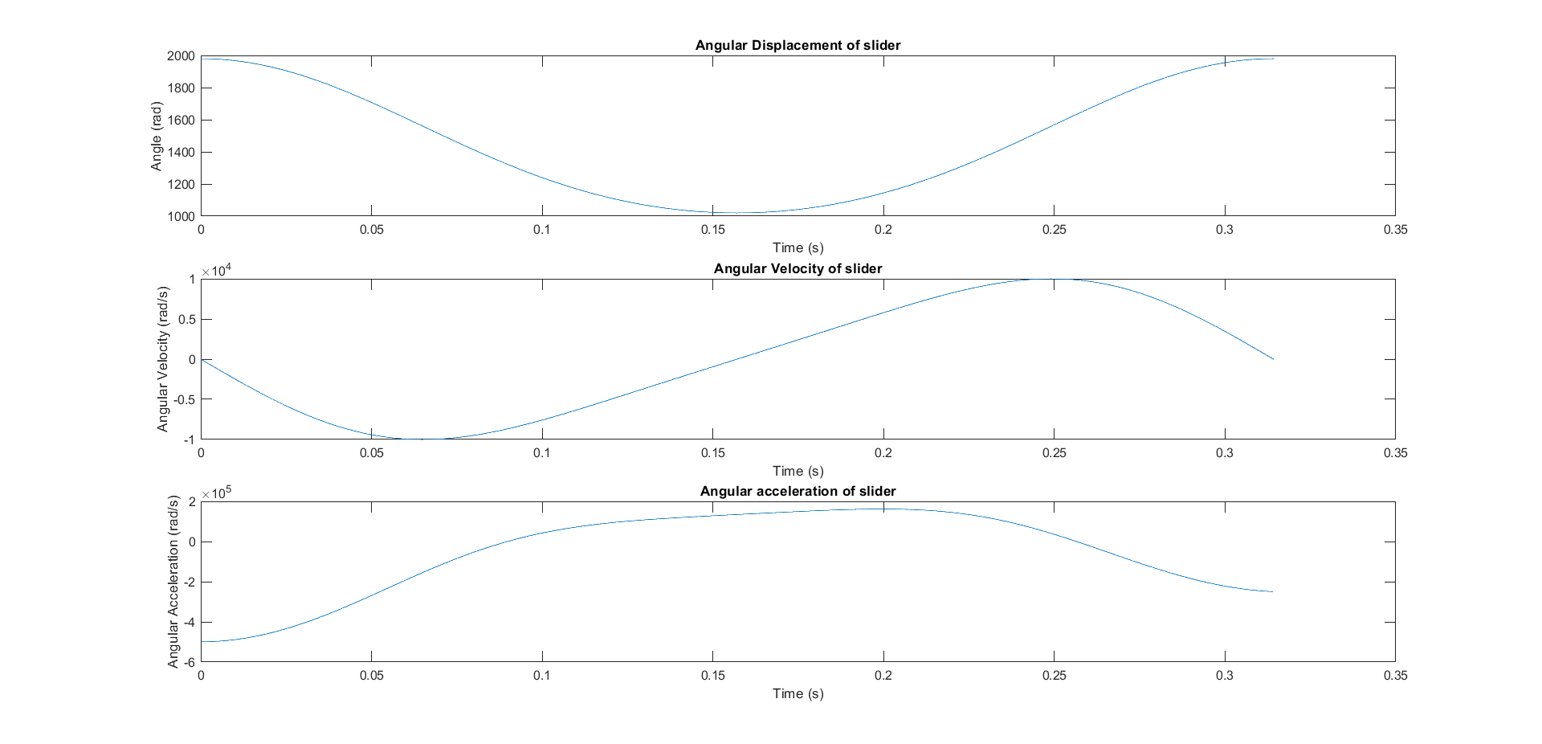
figure;
subplot(3,1,1);
plot(t, r1);
title('Angular Displacement of slider');
xlabel('Time (s)');
ylabel('Angle (rad)');
subplot(3,1,2);
plot(t, v1);
title('Angular Velocity of slider');
xlabel('Time (s)');
ylabel('Angular Velocity (rad/s)');
subplot(3,1,3);
plot(t, a1);
title('Angular acceleration of slider');
xlabel('Time (s)');
ylabel('Angular Acceleration (rad/s)');
Graph:
Prob #2
In a slider-crank mechanism, the dimensions of the links are given as: Length of the crank = 480 mm, Length of the connecting rod = 1600 mm. It has an eccentricity of 100 mm. The crank rotates at an uniform angular velocity of 20rad/s CCW. Plot displacement, velocity and acceleration of the slider for a complete revolution of the crank.
Formula / Equations used:
t = number of different points for plotting graph for one revolution of crank.
theta2 = w2*t
B=(2*e -2*r2*cos(theta2));
C=-2*r2*e*cos(theta2) +r2^2+e^2-r3^2;
r1=(-B + sqrt(B*B -4*C))/2;
theta3 = atan((-r2*sin(theta2))/(r1+e-r2*cos(theta2)));
v1=(-r2*omega2*sin(theta2-theta3)/cos(theta3));
omega3 = (((r2*omega2 * cos(theta2))/(-r3*cos(theta3))));
alpha3 = ((-r2*cos(theta2) * omega2/t + r2*omega2*omega2*sin(theta2) +
r3*omega3*omega3*sin(theta3))/(r3*cos(theta3)));
a1 = -r3*alpha3*sin(theta3) - r2*omega2*sin(theta2)/t -r2*omega2*omega2*cos(theta2) –
r3*omega3*omega3*cos(theta3);

Slide 3
Prob #3
Synthesize a slider crank mechanism in which the slider displacement is proportional to the square of the crank angular displacement in the interval 40°≤0,≤130°. The initial and final value of slider position are 10 cm and 3 cm respectively from the reference frame fixed at crank. Use the three point Chebyshev spacing.
Formula used:
t = number of different points for plotting graph for one revolution of crank.
theta2 = w2*t
a = r3^2 - r4^2 - r2^2 + r1^2 - 2*r1*r2*cos(theta2)
b = -2*r3*r1
c = r3^2 - r1^2 - r2^2 - r4^2 + 2*r2*r4*cos(theta2)
Theta3 = 2*atan2(-b-sqrt(b^2-4*a*c), 2*a)
theta4= theta2 + theta3
omega3 = r2/r3*omega2*sin(theta3
omega4 = omega2 + omega3
alpha3 = r2/r3*omega2*cos(theta3)*omega3 - r2/r3^2*omega2^2*sin(theta3)
alpha4 = alpha3
Code :
clc;
r2 = 2; %length of crank
r3 = 6.6; %length of coupler
r4 = 5.6; %length of follower
r1 = 8; %length of fixed link
% Define angular velocity of the crank
w2 = 5; % rad/s, CCW
% Define time vector for one revolution of the crank
t = linspace(0, 2*pi/w2, 1000);
% Calculate angular displacements, velocities, and accelerations for follower and coupler
for i = 1:length(t)
% Calculate angular displacement of the crank
theta2 = w2*t(i);
% Calculate angles between links using geometric relations
a = r3^2 - r4^2 - r2^2 + r1^2 - 2*r1*r2*cos(theta2);
b = -2*r3*r1;
c = r3^2 - r1^2 - r2^2 - r4^2 + 2*r2*r4*cos(theta2);
theta3(i) = 2*atan2(-b-sqrt(b^2-4*a*c), 2*a); % angle of coupler
theta4(i) = theta2 + theta3(i); % angle of follower
% Calculate angular velocities using time derivative of angular displacements
omega3(i) = r2/r3*omega2*sin(theta3(i));
omega4(i) = omega2 + omega3(i);
% Calculate angular accelerations using time derivative of angular velocities
alpha3(i) = r2/r3*omega2*cos(theta3(i))*omega3(i) - r2/r3^2*omega2^2*sin(theta3(i));
alpha4(i) = alpha3(i);
end

